Slide 1
"THE BASIC PROBLEM OF SOFTWARE DEVELOPMENT IS RISK"
Notes:
Now, it turns out, bankers weren’t the only people thinking about risk.
The quote above is actually the first sentence from Chapter One of a fairly famous book on Software Development.
Does anyone know which one?

Slide 2
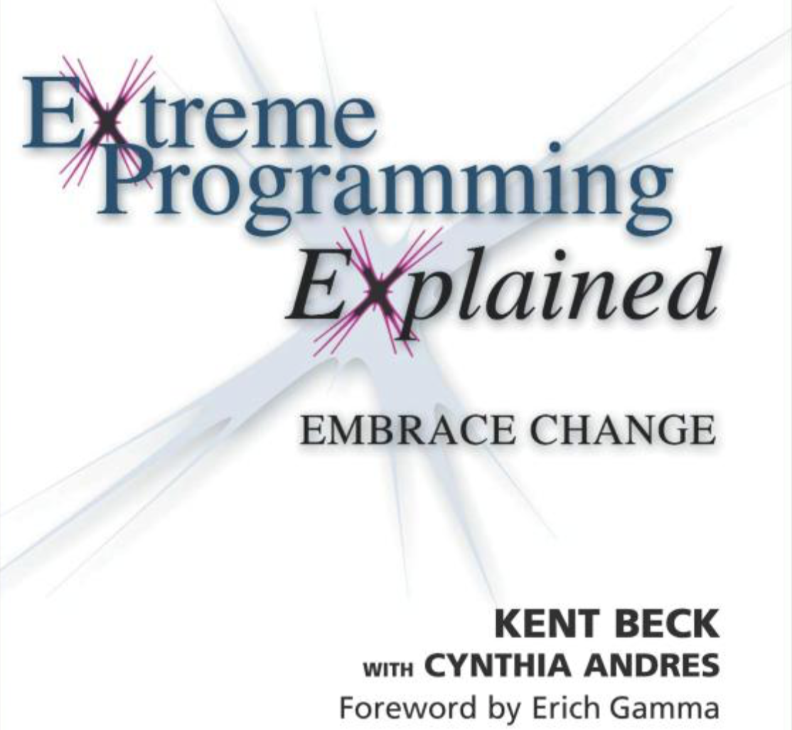
Notes:
Ok, who's heard of this book? Who's heard of Kent Beck?
Anyone read it?
Does anyone actually practice XP in their jobs?
This is the first Agile book I read, whilst at Deutsche Bank that first time.
This seemed like a breath of fresh air compared with what I’d learnt at university about software development.

Slide 3
Notes:
Kent had a bunch of ideas in this book, that really deviated from the accepted “norms” of software development, like Pair Programming.
This is a picture of some guys Pair Programming.
Some people love it. A lot of developers grew to hate XP because of this. They didn’t want to share a keyboard and mouse with someone, and work together.
But what is the point of Pair Programming?
What Kent is trying to avoid by enforcing this is Key Person Risk. That is, having individuals on a team who are the only people who know about a thing.
And if they leave or go on holiday, your project is down the toilet.
That’s the idea, anyway: Pair Programming is a risk-management technique. Specifically, trying to address Key Person Risk.

Slide 4
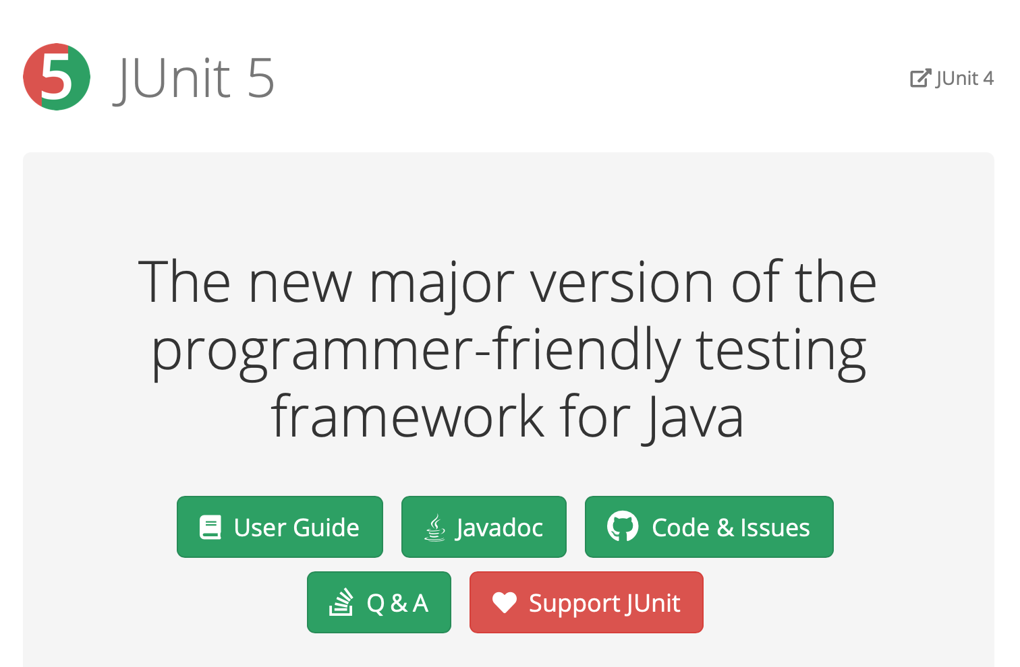
Notes:
Kent Beck also co-invented JUnit. As a Java developer, I use this all the time.
I actually can't imagine coding now without building tests as I go, and having tools to at least understand my coverage.. It just seems so helpful now to have this.
Now, why do we write tests? Why are Unit tests such an integral part of Agile?
I would say, they are managing risk.

Slide 5
Notes:
They are managing a couple of risks: First, you want to test your code before you put it in production. Putting untested code into production is an Operational Risk right there, yeah?
But also, there is a Regression Risk: our code is going to change in the future, we want to change it, and if we have tests, we have some more certainty that when we do change it, we haven’t introduced new bugs.
And, it’s a tradeoff - that’s what’s being shown here. In order to address regression risk, and operational risk, I have to own some extra code in my codebase. So, that’s complexity risk. And building those tests, and maintaining them, that’s going to take some of my schedule up, so there’s a risk to the schedule in writing tests.
Now, if you’re good at Unit Testing, this is a great deal. The trick is to write just enough tests to address the risks on the left. But if you go crazy, you end up turning it into an industry, which blows up those risks on the right.
So, it’s back to this again.

